Slide 1


Natural Fibres and the World Economy
ICNF 2015
Azores
27-29 April 2015
Terry Townsend
Vice Chair DNFI

Slide 2
World Natural Fiber Prod. 2013
33 Million Tons

Slide 3
Farm Value of Production: 2013
US$ 60 Billion

Slide 4
Average Farm Price: 2013
US$/Kg.
Wool, clean $7.3
Silk, raw $4.4
Kapok $3.4
Cotton, lint $1.7
Abaca $1.6
Ramie $1.5
Sisal $1.3
Jute $0.5

Slide 5
World Employment
Definitions Matter:
Households vs Farms vs People
Current or Former
Family Labor vs Paid Employment
Occasional Labor vs Livelihood
300 Million “Involved” in Natural Fiber production each year
Notes:
trend in cotton's share of world fiber use

Slide 6
Producing Households
Millions
Cotton 45
Jute 6
Wool 5
Coir & Bast 1
Silk 0.3
Ramie 0.1
Sisal 0.1
Other 0.5
Total 60

Slide 7
World Cotton Households, 000s
75
9
450
250
30,000
230
9,000
1,400
1,800
80
1

Slide 8
World Cotton Industry

Slide 9
World Cotton Employment
Segment Number Employees
Gins 9,000 400,000
Prs./Whs.* 3,000 30,000
Merchants 10,000 30,000
Spinners 6,000 3,000,000
Weavers 3,000 700,000
Knitters 7,000 1,700,000
6,000,000
*Pressing factories and warehouses
Notes:
trend in cotton's share of world fiber use

Slide 10
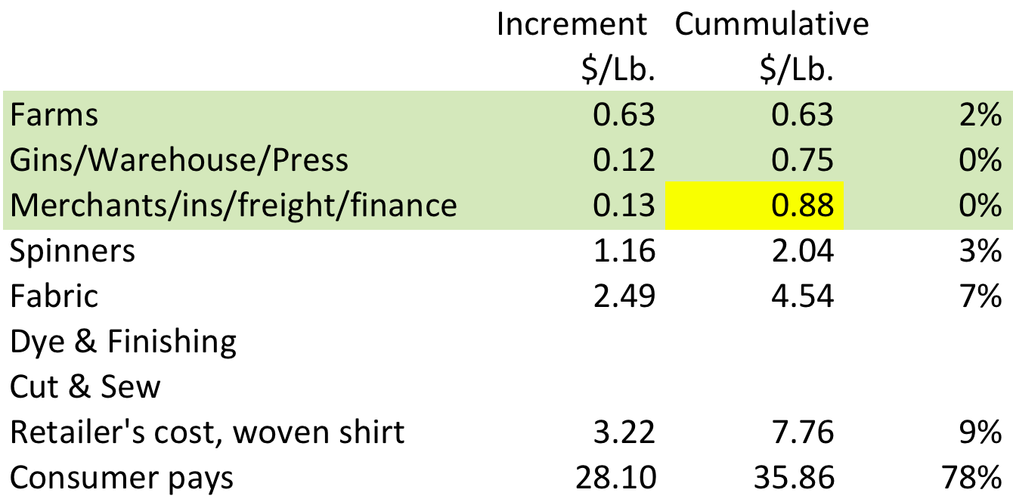
World Cotton Value Chain, 2012
Notes:
trend in cotton's share of world fiber use

Slide 11
Jute: Ganges Delta
5 to 8 cm rainfall needed
per week
25 million; 1/5 population of Bangladesh

Slide 12
World Wool Industry

Slide 13
Natural Fibre Industries

Slide 14

WORLD FIBER PRODUCTION
Million tons

Slide 15
WORLD FIBER PRICES
$ per Kg.

